Slide 1
CFRPM 6.1 Model Update Training
Welcome and Overview-
Jason Learned
Planning & Environmental Management Office
Florida Department of Transportation – District Five
Orlando
Notes:
Jason will Intro himself and discuss the changes and what has been done

Slide 2

CFRPM 6.1 Model Update Training
Training Instructor
Steve Ruegg, PE (PB)
WSP|Parsons Brinckerhoff
Orlando
Notes:
Good Afternoon, Today we will discuss several new elements of the CFRPM model, now included in version 6.1. My name is Steve Ruegg and I’m with WSP|Parsons Brinckerhoff. The goal of this presentation will be to introduce you to these new applications, but recognize that you will need to practice using them to be proficient.

Slide 3
Training Topics
Use of Graphical User Interface
Subarea Analysis Process
Customized MPO Reporting
Use of Dummy/Unused Zone Centroids
Other Informational Items:
External Trip Changes
MPO-Specific Network Attribute Coding
Trip Rate Adjustments
Wiki
User’s Documentation and Validation Reports
Notes:
These are the topics we will cover today

Slide 4
Use of Graphical User Interface
Notes:
The Graphical User Interface, or GUI, has been updated. It uses the standard CUBE scenario key manager.

Slide 5
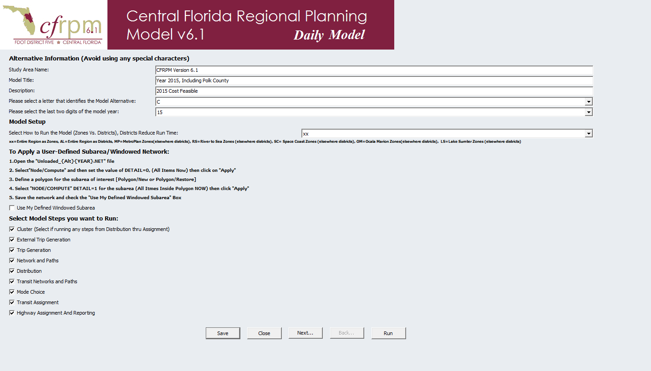
First Page of User-Defined Keys
Notes:
On the first page, we have a section describing the alternative, including name, study area, description, alternative code letter and two digit year.
After this, you have a choice of whether to run the model by zones (the default) or by districts.
A third section describes the procedures for running a subarea or windowed model, which we will discuss later, followed by a list of model modules, which normally will all be selected.

Slide 6
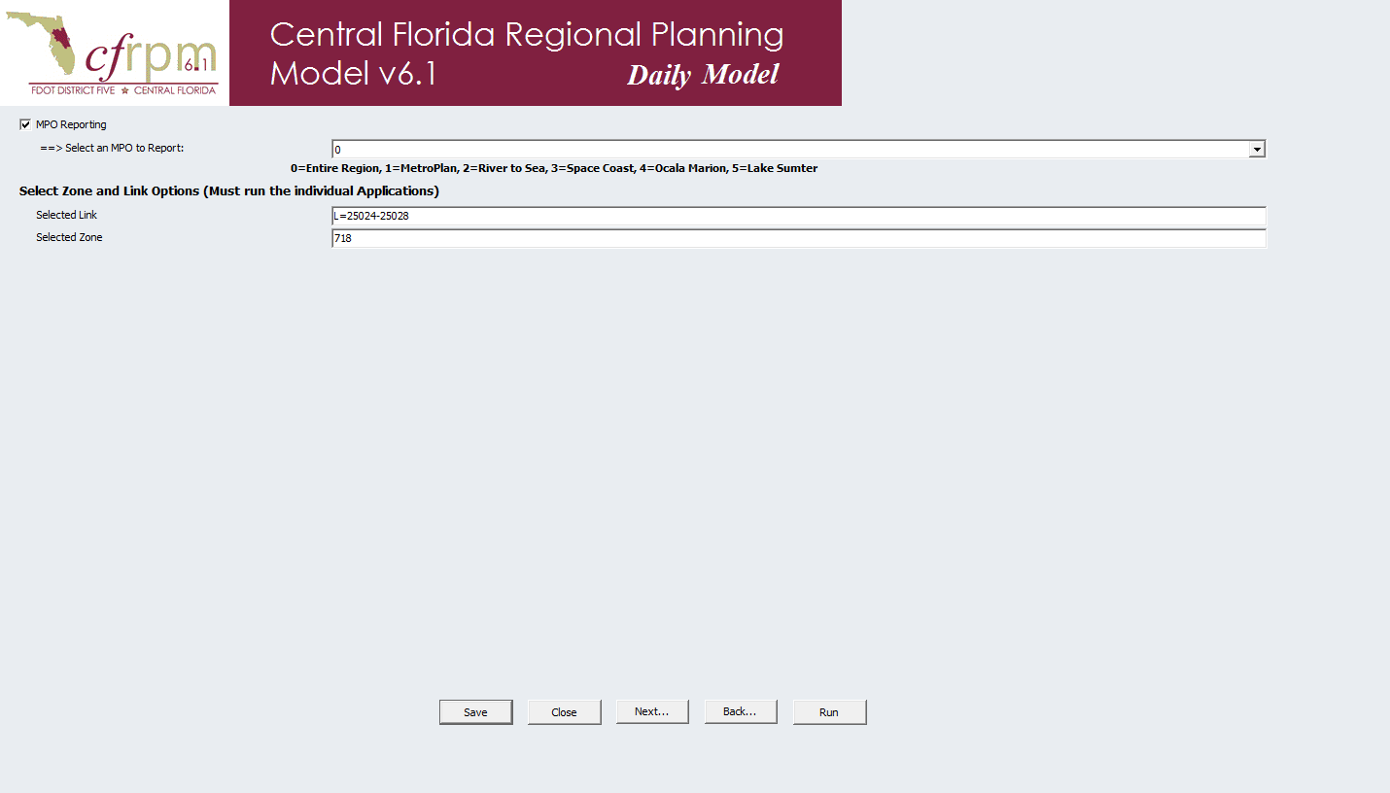
Second Page of User-Defined Keys
Notes:
The second page finishes up with the MPO reporting option and an option to select a specific MPO to report, or just use the entire region.
Finally, the user is presented with an option to specify a select zone and/or link for analysis.

Slide 7
Example using CUBE Scenario Window
Notes:
At this point, we will jump out of the slides and into the CUBE catalog (daily model) and highlight all CUBE scenario manager windows, but specifically the first two where the user makes changes to specify the kind of model run. The later pages are parameters, most of which should remain unchanged.

Slide 8
Subarea Analysis Process
Notes:
A subarea modeling process has been added as well.

Slide 9
Subarea Application Options
Run a specific MPO/TPO area by zone, rest of region by district
Run entire region as districts
Run a user-selected subarea, with the rest of the region by district
Notes:
There are three options for subarea modeling. The first two allow subareas to be pre-defined by district. The third option allows the user to select a specific subarea, and the rest of the region is modeled as districts. This is also known as subarea windowing.

Slide 10
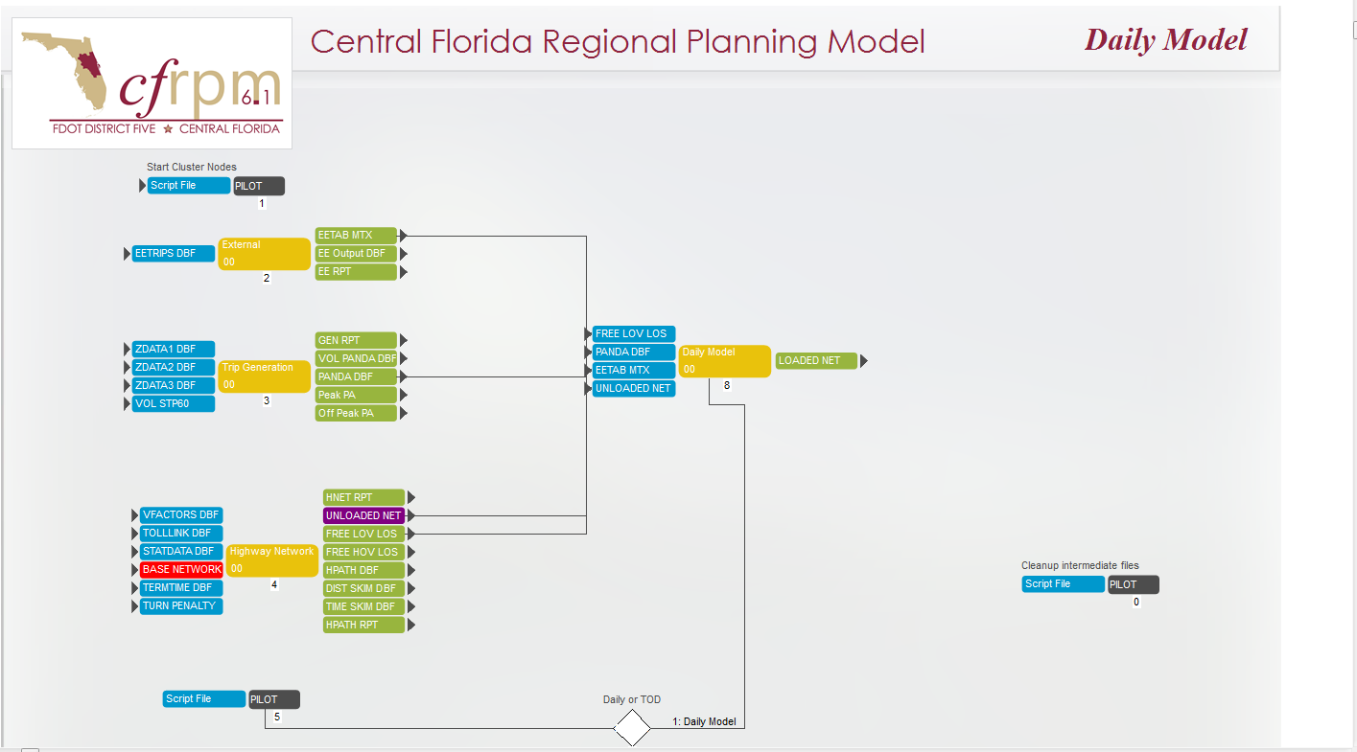
Step 1: Edit Input Highway Network
Notes:
The user-selected subarea process has four preparatory steps. First, open the input highway network.

Slide 11
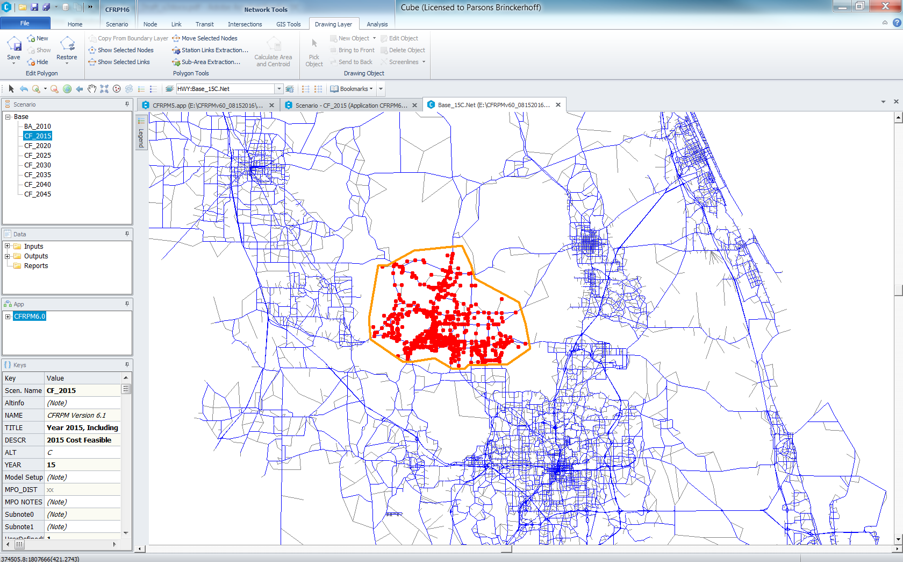
Step 2: Define Subarea
Notes:
Secondly, using the “drawing layer” menu, define a subarea. Good practice is to avoid cutting centroid connectors, and avoid concave boundary shapes.

Slide 12
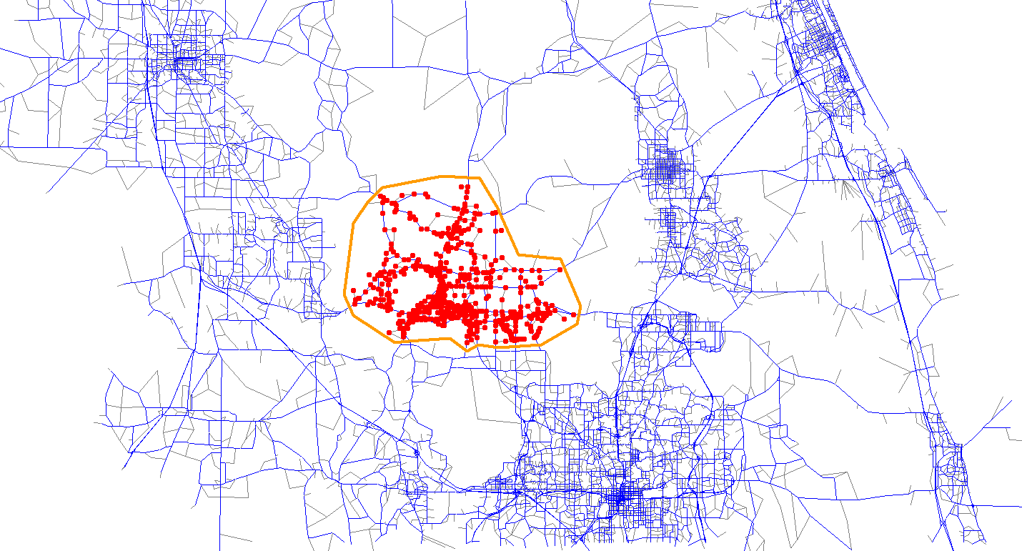
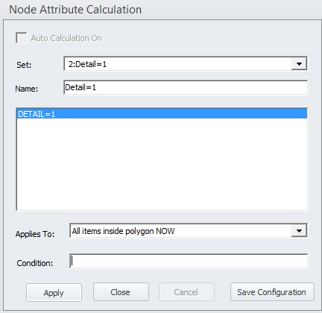
Step 3: Code Nodes in selected area DETAIL=1
Notes:
Third, tag all nodes within the boundary with DETAIL=1. You may have to add the attribute “DETAIL” as a node attribute first. DETAIL should have a value of 0 for all nodes outside the boundary. The node attribute calculation window allows you to change only those nodes within the selected boundary.
Save the boundary.

Slide 13
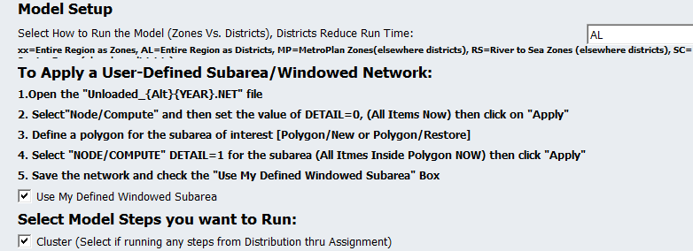
Step 4: Select the Defined Window Subarea
The model is run with the selected subarea as TAZs and the rest of the model as districts using “AL”
Notes:
In step 4, check the “Use My Defined Windowed Subarea”, select the “AL” option for the mode with which to run the model and execute. All areas outside the window will be modeled as districts.

Slide 14
Example: Defining a subarea
Notes:
At this point, we will jump to the catalog and show how we define a subarea, and what keys to change in the GUI.
I will run a few subarea model runs before this to document run times.

Slide 15
Customized MPO Reporting
Updates and New outputs
Notes:
A new set of reports are also available.

Slide 16
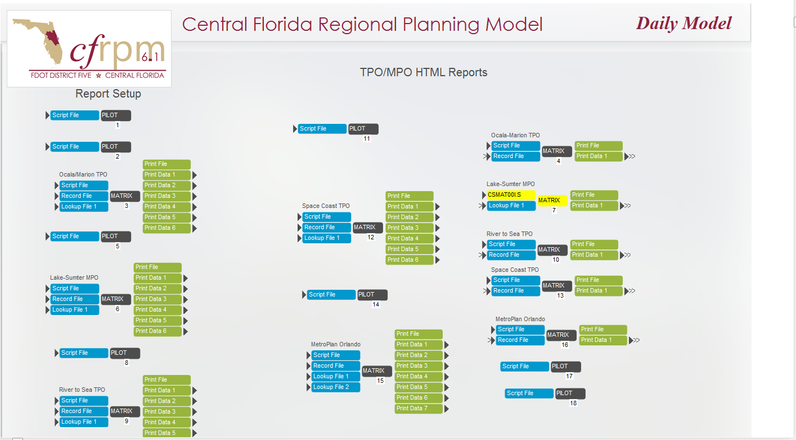
MPO/TPO Reports
Notes:
A series of MPO reports are produced in this section.

Slide 17
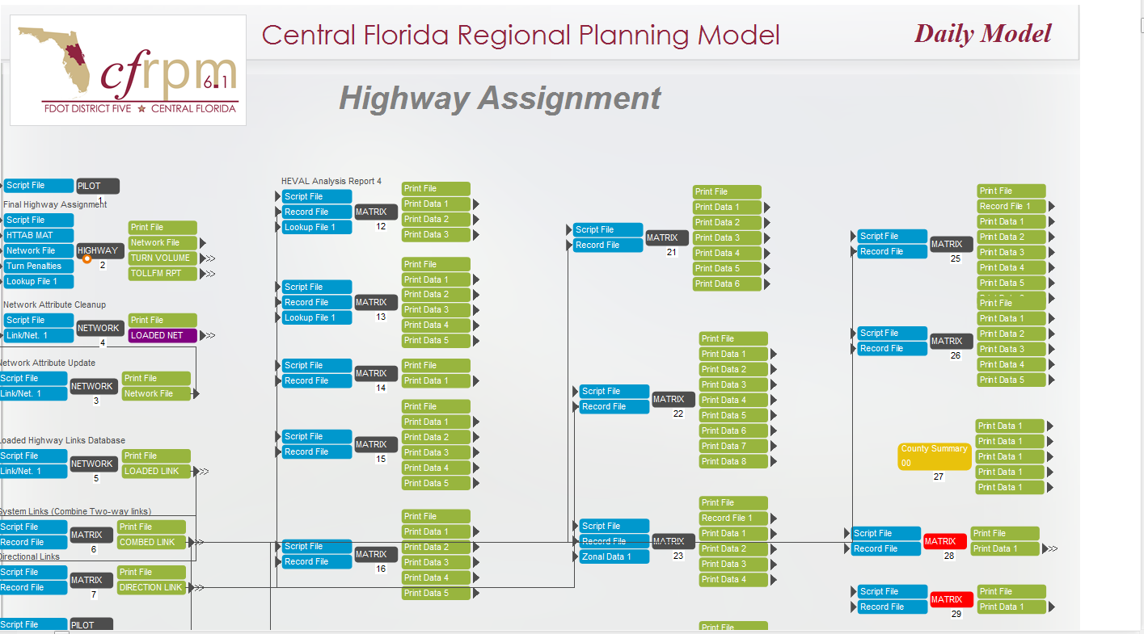
Formatted Summaries
Notes:
Here is the location of the summary reports – they can be “dragged and dropped” into excell

Slide 18

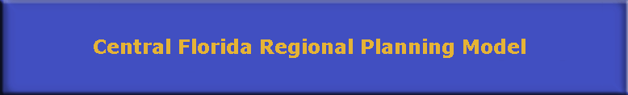
Summary Report: HASSIGN.RPT
Heval Reports
By Area Type, number of Lanes and Facility Types
Links and percent of links
Percent of Links with Counts
System Miles, Lane miles
Average Link Length
Volume, VMT and VHT for Counted Links – assigned and counts
Volume, VMT and VHT for all links
Freeflow and congested speeds
Screenline volumes
RMSE reports
By MPO
Notes:
A file, called HASSIGN.RPT may be read into an excel spreadsheet. It produces the traditional “HEVAL” reports and is stratified by MPO, number of lanes and facility type, along with specific MPO reports.

Slide 19
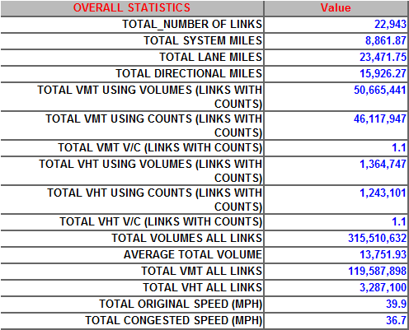
Summary Report
Notes:
Here is one example of a portion of this report. Other reports are available specific to MPOs, and each model step.

Slide 20
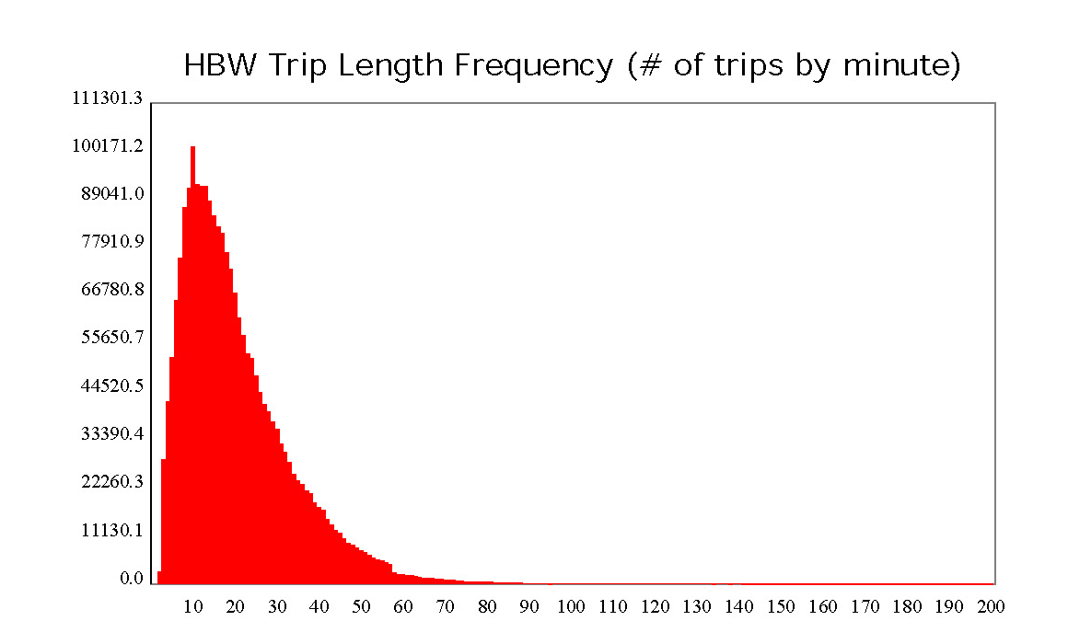
Graphical Results
Notes:
A series of graphics are also available covering most model steps. Here we see a trip length frequency distribution for HBW trips.

Slide 21
Example: Reports
Notes:
At this point we will jump out of the presentation and into a “pre-baked” model scenario. We will show how to drag the report files into Excel, and walk through the reports, showing the kinds of information available.

Slide 22
Use of Dummy/Unused Zone Centroids
Notes:
The network contains a set of unused, or dummy zone centroids which can be used for specialized studies where more detail is required.

Slide 23
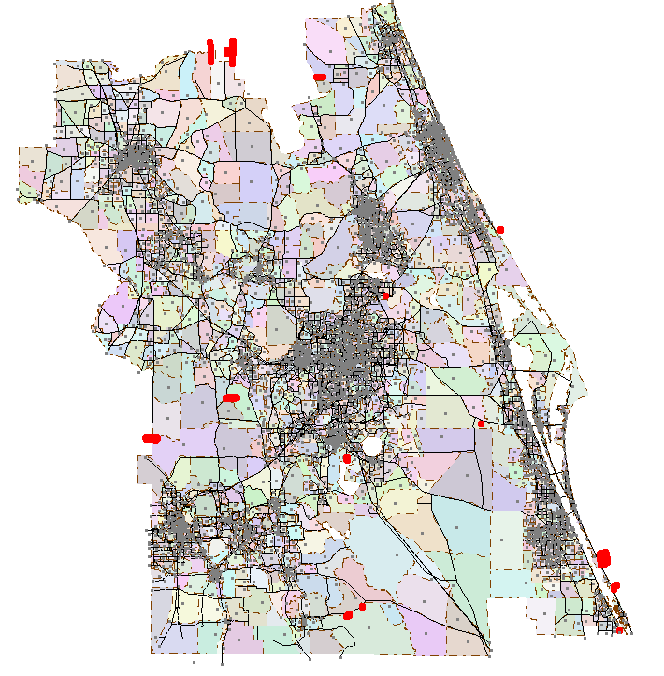
Dummy Zone Locations
612 Unused Zones
May be used to subdivide existing zones
Edit network
Disconnect dummy zone
Move to desired Location
Re-connect to network
Update field TSNAME
Update field MPO
Notes:
There are 612 unused zone centroids. They are connected to the network, but the model will not normally assign any trips to or from these zones.
To use them,
Disconnect dummy zone
Move to desired Location
Re-connect to network
Update field TSNAME
Update field MPO

Slide 24
Informational Items
Through Trip Pre-Loading
MPO Codes on Centroids
Trip Generation Rate Changes
On-line Documentation
Model Documentation
Model Validation Report
Notes:
Several other changes have been made to the model which are largely transparent to the user. These include:
Through trips are now pre-loaded so they are assigned to the shortest free-flow paths. Link Capacity is adjusted to account for through trips.
It is important that the MPO node attribute on nodes and centroids be accurate – generally this should only be checked when modifying the network
The trip generation rates have been updated. Lifestyle-based trip production rates are now the norm for all regular generation
There will be a on-line Wiki documentation available soon.
Model documentation will be available as well as the validation report.

Slide 25
End of Presentation Open to Questions
Thank you!

Slide 26
External Trip Changes
Preloading External “EE” Trips
Notes:
External trip models have changed as well. Primarily, this involves how the through trips, or external to external trips are assigned.

Slide 27
Previous Model: EE part of UE Assignment
Two Models: Daily and Time of Day Models Both models do only “UE” assignment.
External Trips by Time Period: Consists of EE and IEEI by LOV, HOV, LTRK and HTRK vehicle classes.
Assignment: All External Trips (EE and IEEI) are assigned as one class external trip class under User Equilibrium “UE” Assignment.
Logic: Most of the through “EE” trips remain on major facilities irrespective of local traffic conditions. For this reason,
EE trips should be preloaded
Preload network can be used as the starting point for the resident model
Notes:
In the previous model, through trips were assigned along with all other internal and IX trips. However, through trips are longer, and often involve drivers unfamiliar with the region’s traffic patterns, or are long-haul trucks. In both cases, it is reasonable to believe that these trips will not be as sensitive as local drivers to congestion when determining their path through the region. Therefore, the new model uses a through trip pre-load.

Slide 28
EE Trips by Time of Day
External trips by time of day “EE_A10.MAT” were computed from the daily external trips “EETAB.MAT” and diurnal factors.
Current model: EE_A10.MAT is combined with IE+ EI trips and Diurnal Factors were applied to split by time period.
Preloaded Model: EE_A10.MAT were not combined with IE + EI and Diurnal Factors were applied directly on EE_A10.MAT to produce EE trips by time of day.
 | EETAB_A10.MAT | EE_A10.MAT | Special Trips
AUTO | 42,348 |  | IE + EI + EE | IE + EI (After Removal of EE) | EE Trips
EE_LOV |  | 26,571 | 270,775 | 244,204 | 26,571
EE_HOV |  | 8,102 | 210,225 | 202,123 | 8,102
EE_LRTK |  | 1,908 | 1,335,500 | 1,333,591 | 1,909
EE_HRTK |  | 5,767 | 346,655 | 340,888 | 5,767
Total | 42,348 | 42,348 | 2,163,155 | 2,120,806 | 42,349
Notes:
In the new model, through trips are extracted from the IXXI trip tables, and assigned separately.

Slide 29
Script Modifications for EE Preload: Time of Day
Distribution > MATMAN > MATMAT00T.S: Computes peak external trips by vehicle class: LOV,HOV, LTRK and HTRK from EXTTRP2_PK.TEM, AALOVHOV_PK.TEM. Additionally subtracts these EE trips from SPECIAL_{ALT}{YEAR}_PK.MAT and writes out SPECIAL_no_EE_{ALT}{YEAR}_PK.MAT
Distribution > MATMAN > MATMAT00Q.S: Modified to use SPECIAL_no_EE_{ALT}{YEAR}_PK.MAT instead of all external peak trips.
Modechoice > MCMAT00X.S: Computes peak external trips by four vehicle classes: LOV,HOV, LTRK and HTRK from Temp\EXTTRP2_OP.TEM, AALOVHOV_OP.TEM, EXTTRP2_PK.TEM, AALOVHOV_PK.TEM. Additionally subtracts these EE trips from SPECIAL_{ALT}{YEAR}.MAT and writes out SPECIAL_no_EE_{ALT}{YEAR}.MAT
Distribution > MATMAN > MCMAT00U.S: Modified to use SPECIAL_no_EE_{ALT}{YEAR}.MAT instead of all external peak trips.
Assignment > TSHWY00E.S: New highway assignment to assign EE – AM trips. Writes out loaded external AM network HWYLOAD_AM_{ALT}{YEAR}_EE.NET
Assignment > TSHWY00F.S: New highway assignment to assign EE – MD trips. Writes out loaded external AM network HWYLOAD_MD_{ALT}{YEAR}_EE.NET
Assignment >TSHWY00G.S: New highway assignment to assign EE – PM trips. Writes out loaded external AM network HWYLOAD_PM_{ALT}{YEAR}_EE.NET
Assignment >TSHWY00L.S: New highway assignment to assign EE – NT trips. Writes out loaded external AM network HWYLOAD_NT_{ALT}{YEAR}_EE.NET
Notes:
Here are the specific modifications made to the script to accommodate the through trip preload for the time of day model

Slide 30
Script Modifications for EE Preload: Daily
Distribution > MATMAN > MAMAT00K.S: EE trips are excluded from EXTTRP3.TEM .
Computes output\EE_{ALT}{YEAR}.MAT external trips by vehicle class: LOV,HOV, LTRK and HTRK from EXTTRP2_PK.TEM, AALOVHOV_PK.TEM.
Assignment > HSHWY00E.S: New highway assignment to assign EE trips. Writes out loaded external network HWYLOAD_EE{ALT}{YEAR}_EE.NET The network from EE Preload is used as input for resident model assignment.
Assignment > HSHWY00A.S: Revised the assignment script to use a reduced capacity due to preloaded external volume.
Notes:
For the daily model, these are the script modifications.

Slide 31
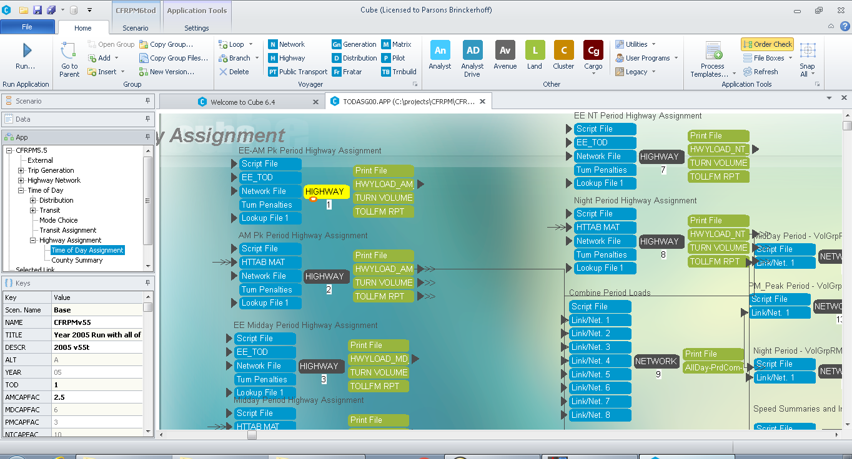
Added Preload EE Assignment: Time of Day
EE Preload
UE Assignment
Notes:
For the Time of day model, here is where the EE preload occurs. Note that the capacity is reduced on a link basis to reflect the EE loads by link. This is done for each time period.

Slide 32
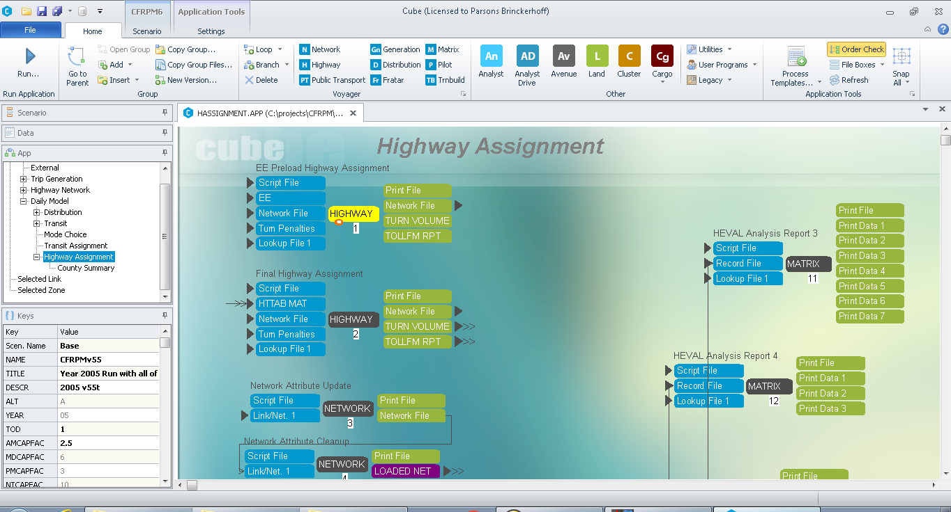
Added Preload EE Assignment: Daily
EE Preload
UE Assignment
Notes:
For the Daily model, we have virtually the same preload and regular loading procedure.

Slide 33
MPO Specific Network Attribute Coding
Notes:
Since we have many summaries specific to MPOs, it is important to have the correct MPO codes entered into the network

Slide 34
MPO Specific Roadway Attributes: Coding and Usage
The “MPO” attributes from TAZ nodes and roadway input network nodes in CFRPM 6 need to be coded correctly.
When the model choice application runs, the error coded “MPO” attributes may cause spurious model choice results.
Notes:
Since several models have MPO-specific codes, the incorrect code may result in erroneous results, including mode shares.

Slide 35
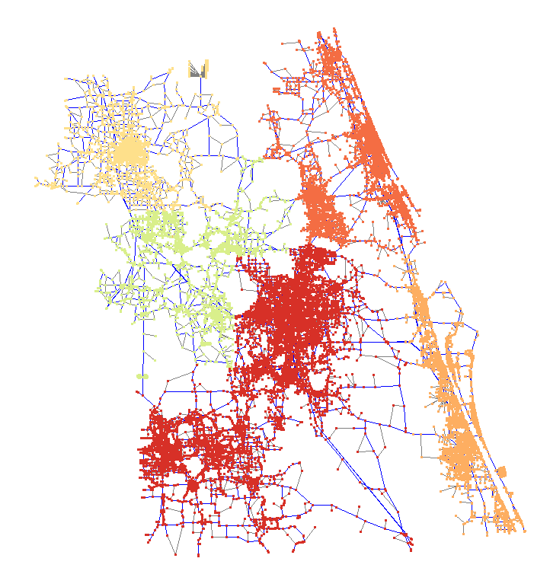
MPO Node Codes
By County/MPO
Notes:
This is a graphic showing the MPO codes in the network. Note that these are node attributes but are used to populate link attributes automatically.

Slide 36
MPO Specific TAZ Attributes: Coding and Usage
CFRPM 6.0 and CFRPM 6.1 Internal TAZ Range
Notes:
For version 6.1, a code of 1-5 is valid for the MPO codes. This shows the range of codes for each jurisdiction.

Slide 37
MPO Specific Roadway Attributes: Coding and Usage
The following step will be added in the model to check the error. If an error happens, the model will stop processing.
Any TAZ’s MPO attribute that does not reflect the proper coding based on current CFRPM 6 internal TAZ range.
The MPO attribute was found to be coded as 0 for any roadway input network node.
Notes:
An automatic check is performed to ensure proper MPO coding. Note that when adding new zones, it is important to have the proper MPO code.

Slide 38
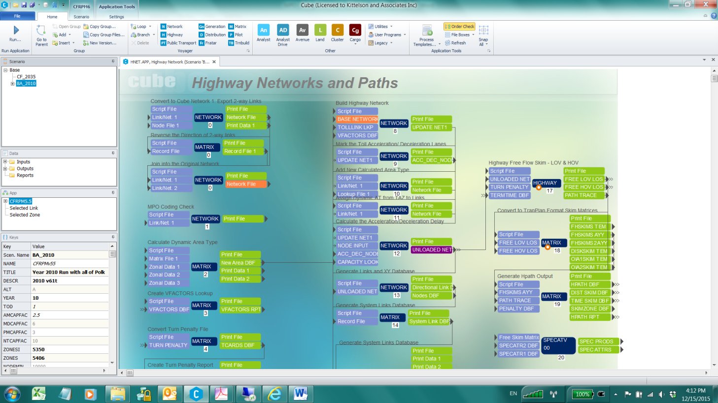
MPO Specific Roadway Attributes: Coding and Usage
Notes:
This is the location of the automatic check.

Slide 39
Trip Rate Adjustments
Standard and lifestyle
Notes:
Trip rates have been updated. There are two types of trip rates

Slide 40
Standard Trip Generation
Production Cross-Classification by
County
Type (SF,MF,Hotel/Motel)
Autos
Size
Resident Status
Attraction rates stratified by County.
Applied only to special generators
Purposes:
HBW, HBShop, HBSocRec, HBOther, NHB
Notes:
Standard trip rates use a cross-classification trip production model, stratified by county, household type, number of autos, household size and resident status. However, these rates are only applied to special generators.

Slide 41
Lifestyle-based Trip Generation
Production Cross-Classification by
Auto Ownership
Worker/HHSize Index
0 Workers, 1 person
1 Worker, 2 persons
2+ Workers, 3 persons
4+ persons
Child Presence (with or without)
Attraction rates are global
Applied to all counties.
Purposes:
HBW, HBShop, HBSocRec, HBOther, HBSchool, NHBW, NHBO
Notes:
Of more general interest, the life-style-based trip production rates are based on auto ownership, number of workers, household size, presence of at least one child. These are the default rates and are applied to all counties. Trip purposes include HBW, HBShopping, HB Social-Recreational, Home-based School, Non-Home-based work trips, and Non-Home-based non-work trips. Trip rates are not county-specific.

